Slide 1

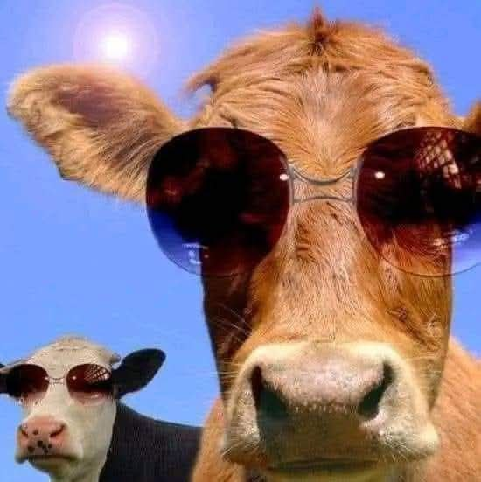
MooNet
Livestock in the Era of AI and IoT

Slide 2
Table of contents
01
Our Team
10
Tools & Technologies
02
Challenges
11
System Design
03
Our Solution
12
Feed Optimization
04
Market Analysis
13
Datasets
05
SWOT Analysis
14
Disease Detection
06
Competitor Analysis
15
Smart Chatbot
07
Business Model
16
System Demo
08
Our Roadmap
17
Upcoming Features
09
Project Timeline

Slide 3

01
Our
Team

Slide 4
01 Our Team
Our
Team

Slide 5

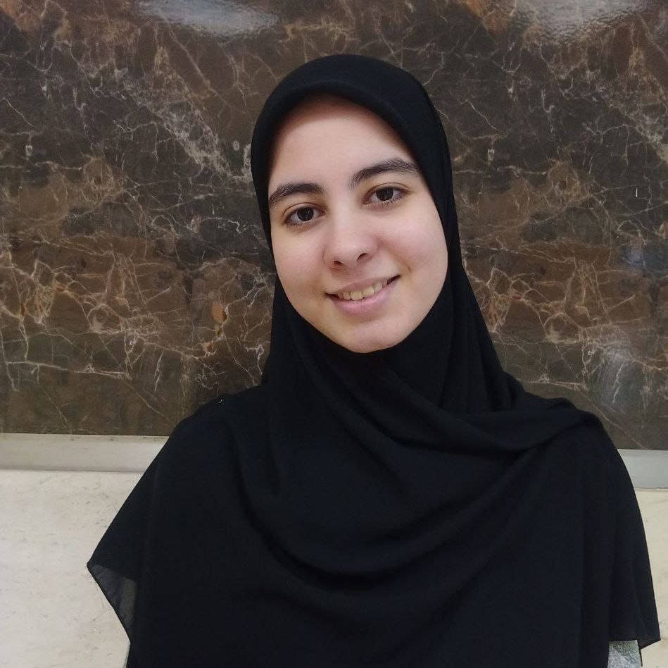



01 Our Team
Heba Atef
Tolan
Mennat-Allah Yousri
Mennat-Allah Medhat
Sohila Ayman Lashien
Abdelrahman El-Sayed
Supervised by
Assoc.Prof. Mina Ibrahim Samaan Ibrahim

Slide 6

02 Challenges
Challenges

Slide 7
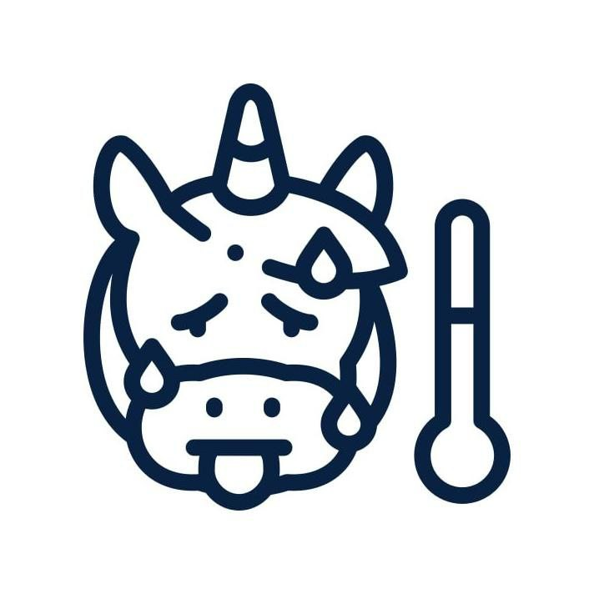


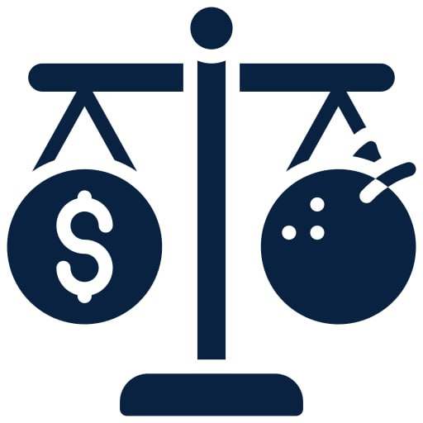

02 Challenges
Unsuitable Environmental
Conditions
Water Shortage
or Waste
Delayed Disease
Detection
High Costs
for Feed
Lack of Trusted Expert Guidance

Slide 8
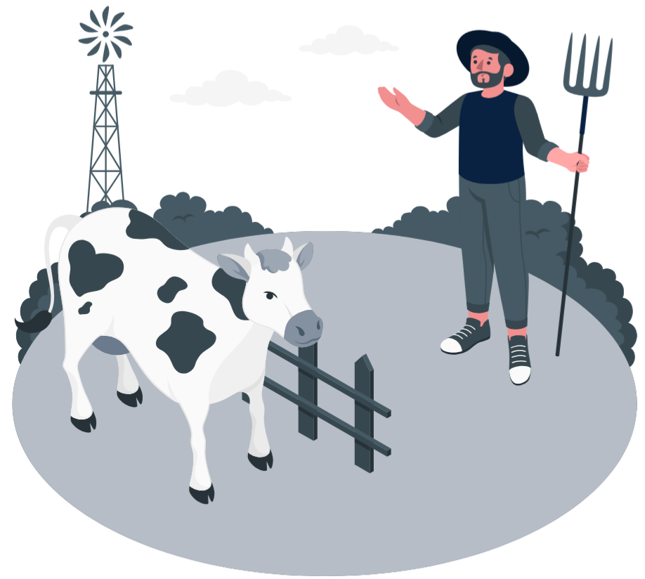
03 Our Solution
Our Solution​

Slide 9
03 Our Solution
A system uses modern technology such as AI and IoT to develop traditional livestock raising methods.
The administrator can depend on the system to make automatic needs, get immediate information, and take correct decisions. This will improve animal care and increase profits.

Slide 10


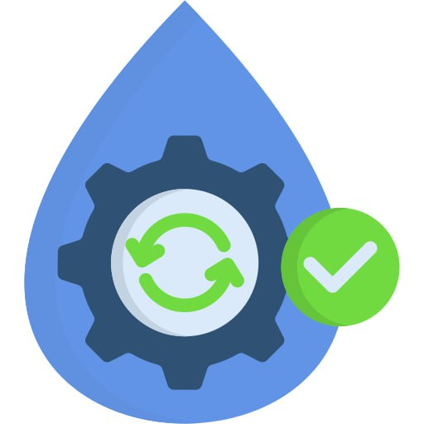

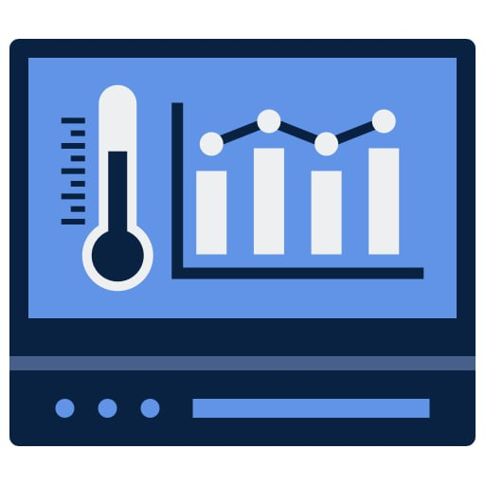



03 Our Solution
Early Detection of Diseases
Real Time Monitoring
Automated Water Management
Automated Data Collection
Monitoring Environmental Conditions
Smart Chatbot Powered by AI
Feed Analysis and Cost Reduction
Smart Application

Slide 11

Market Analysis
04 Global Market

Slide 12
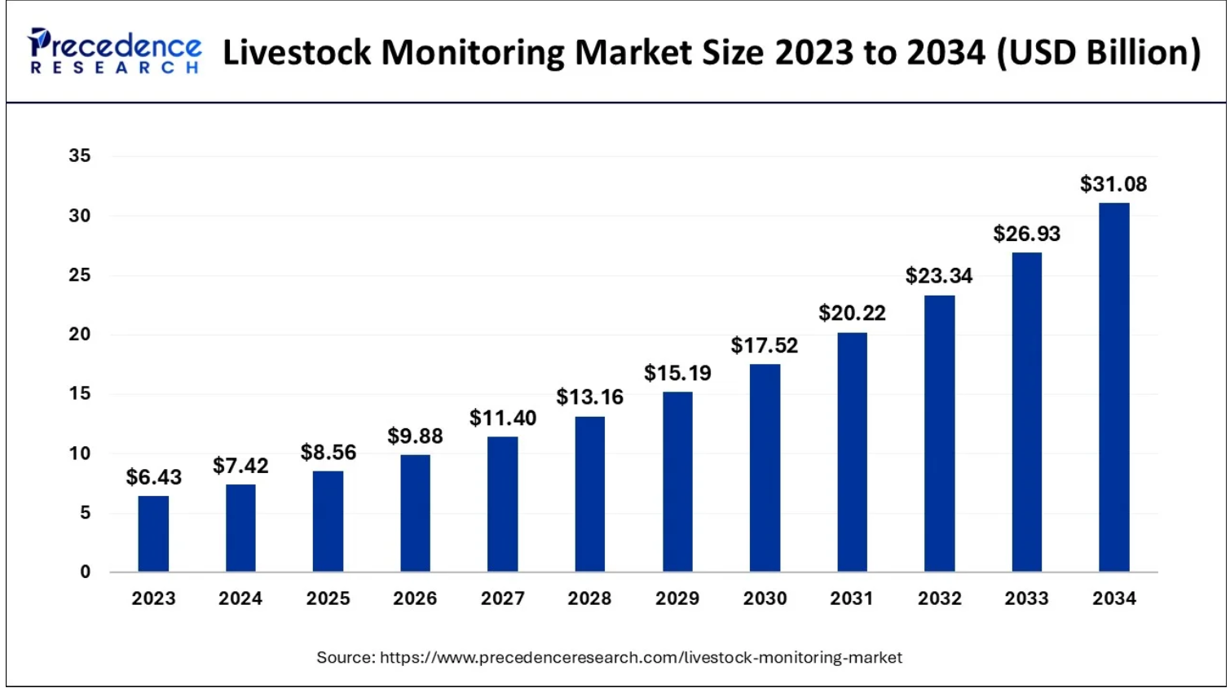
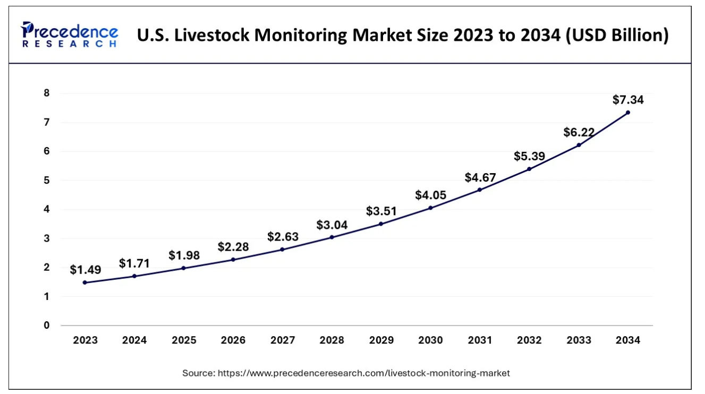
04 Global Market
Expanding at a CAGR of 15.40% from 2024 to 2034.
Rising at a CAGR of 15.60% from 2024 to 2034.

Slide 13
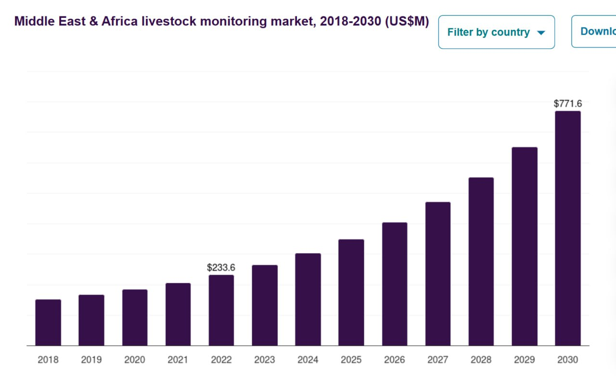
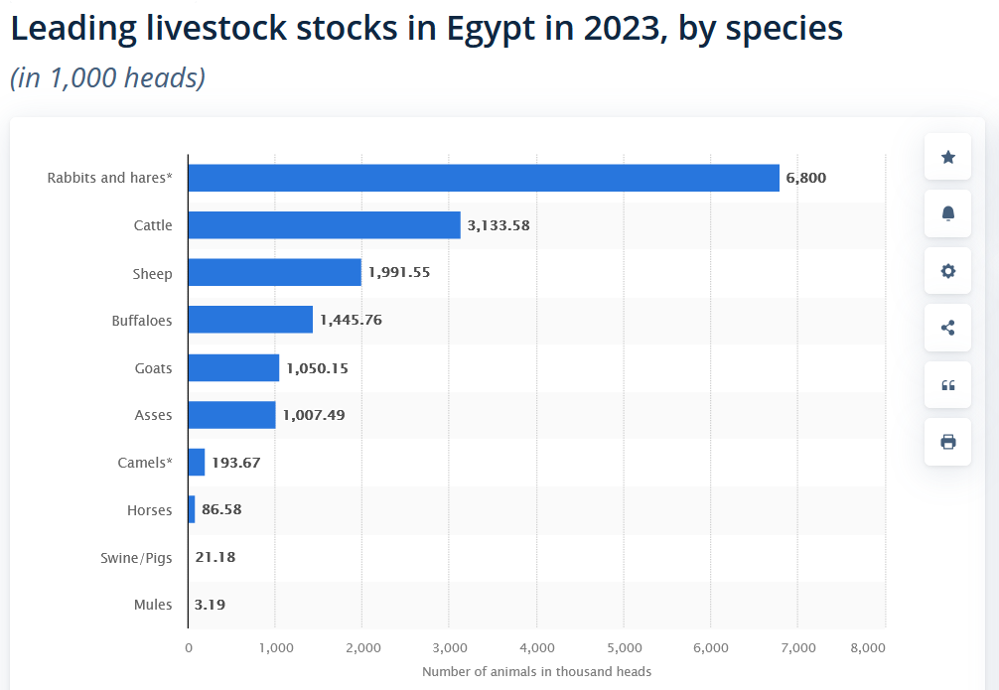
04 Local Market
MEA region accounted for 4.4% of the global livestock monitoring market in 2022.
In 2023, the cattle stock in Egypt amounted to about 3.1 million heads.

Slide 14

05
SWOT Analysis

Slide 15
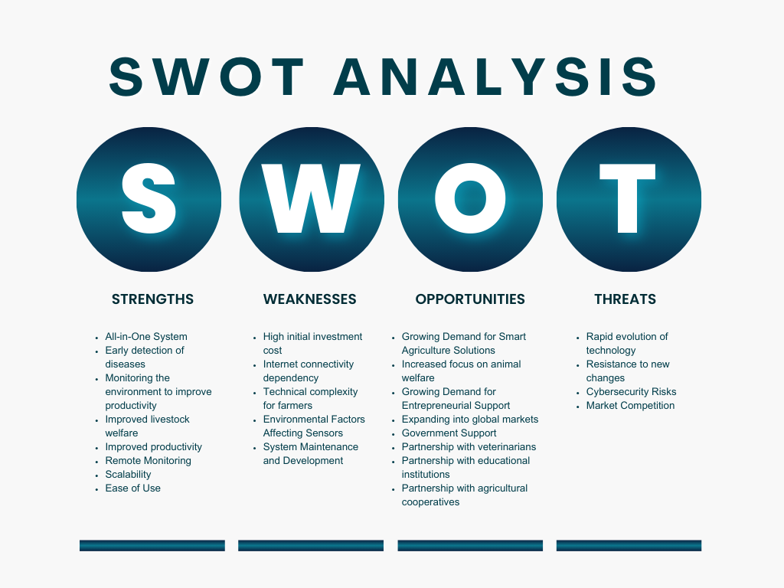
05

Slide 16

Competitor Analysis
06

Slide 17
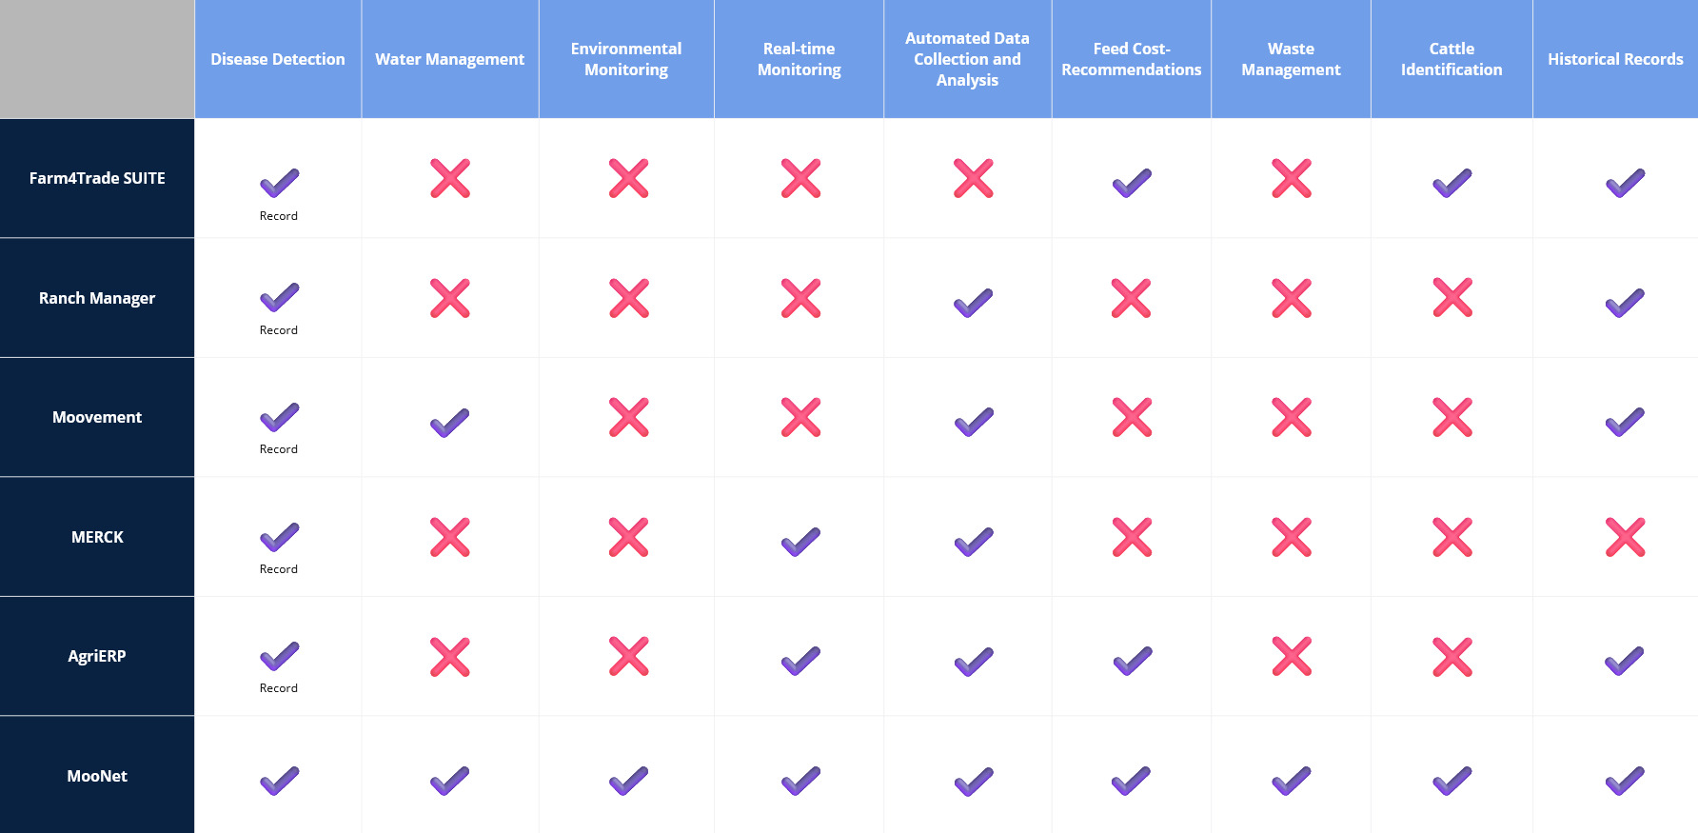
Competitive Analysis
“We don’t have competitors in Egypt”
06

Slide 18
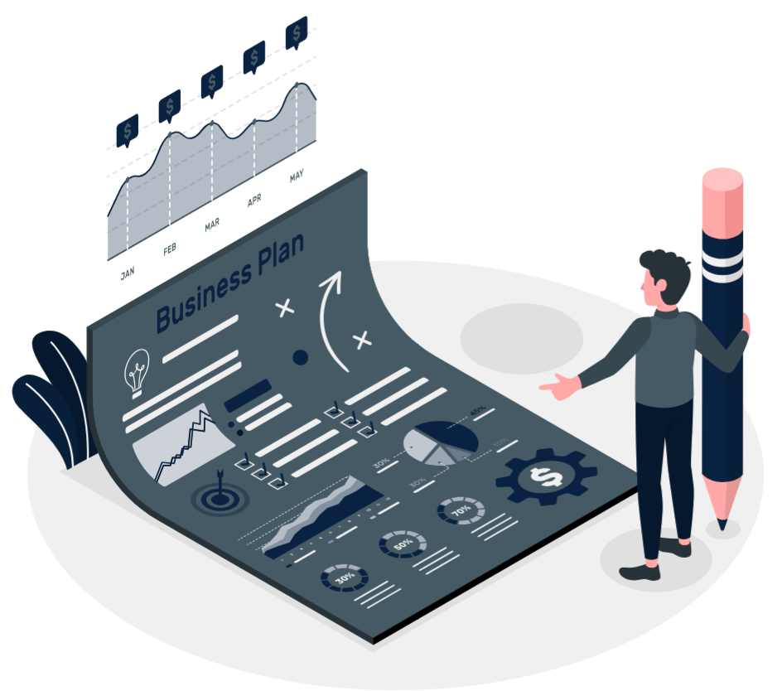
Business Model
07

Slide 19
07
Our Business Model Canvas​
IoT Device Manufacturers Livestock Owners Agricultural Organizations Veterinary Organizations Government Agencies | AI Models for Disease Detection & Productivity IoT Sensor Integration Data Analysis Test System on farms Mobile App | Healthier Livestock & Higher Profits Better Livestock Productivity Smarter Decisions Without Extra Effort Manage Your Farm From Anywhere Cost Reduction without Compromising Health Waste Management, Livestock Identification & Historical Records |  | Customer Support & Training Feedback Mechanism | Livestock Farmers Agricultural Cooperatives Veterinary Clinics Government
 | Devices & Sensors Server Testing Farms |  |  | Direct Sales to Farms Mobile App Veterinary Partnerships Social Media
Devices & Sensors Maintenance and Updates Marketing |  |  | Subscriptions Premium Features Hardware Installation Fees Sponsorships
Key partners
Key Activities
Value Proposal
Customer Relationship
Customer Segments
Key Resorces
Channels
Cost Structure
Revenue Stream

Slide 20
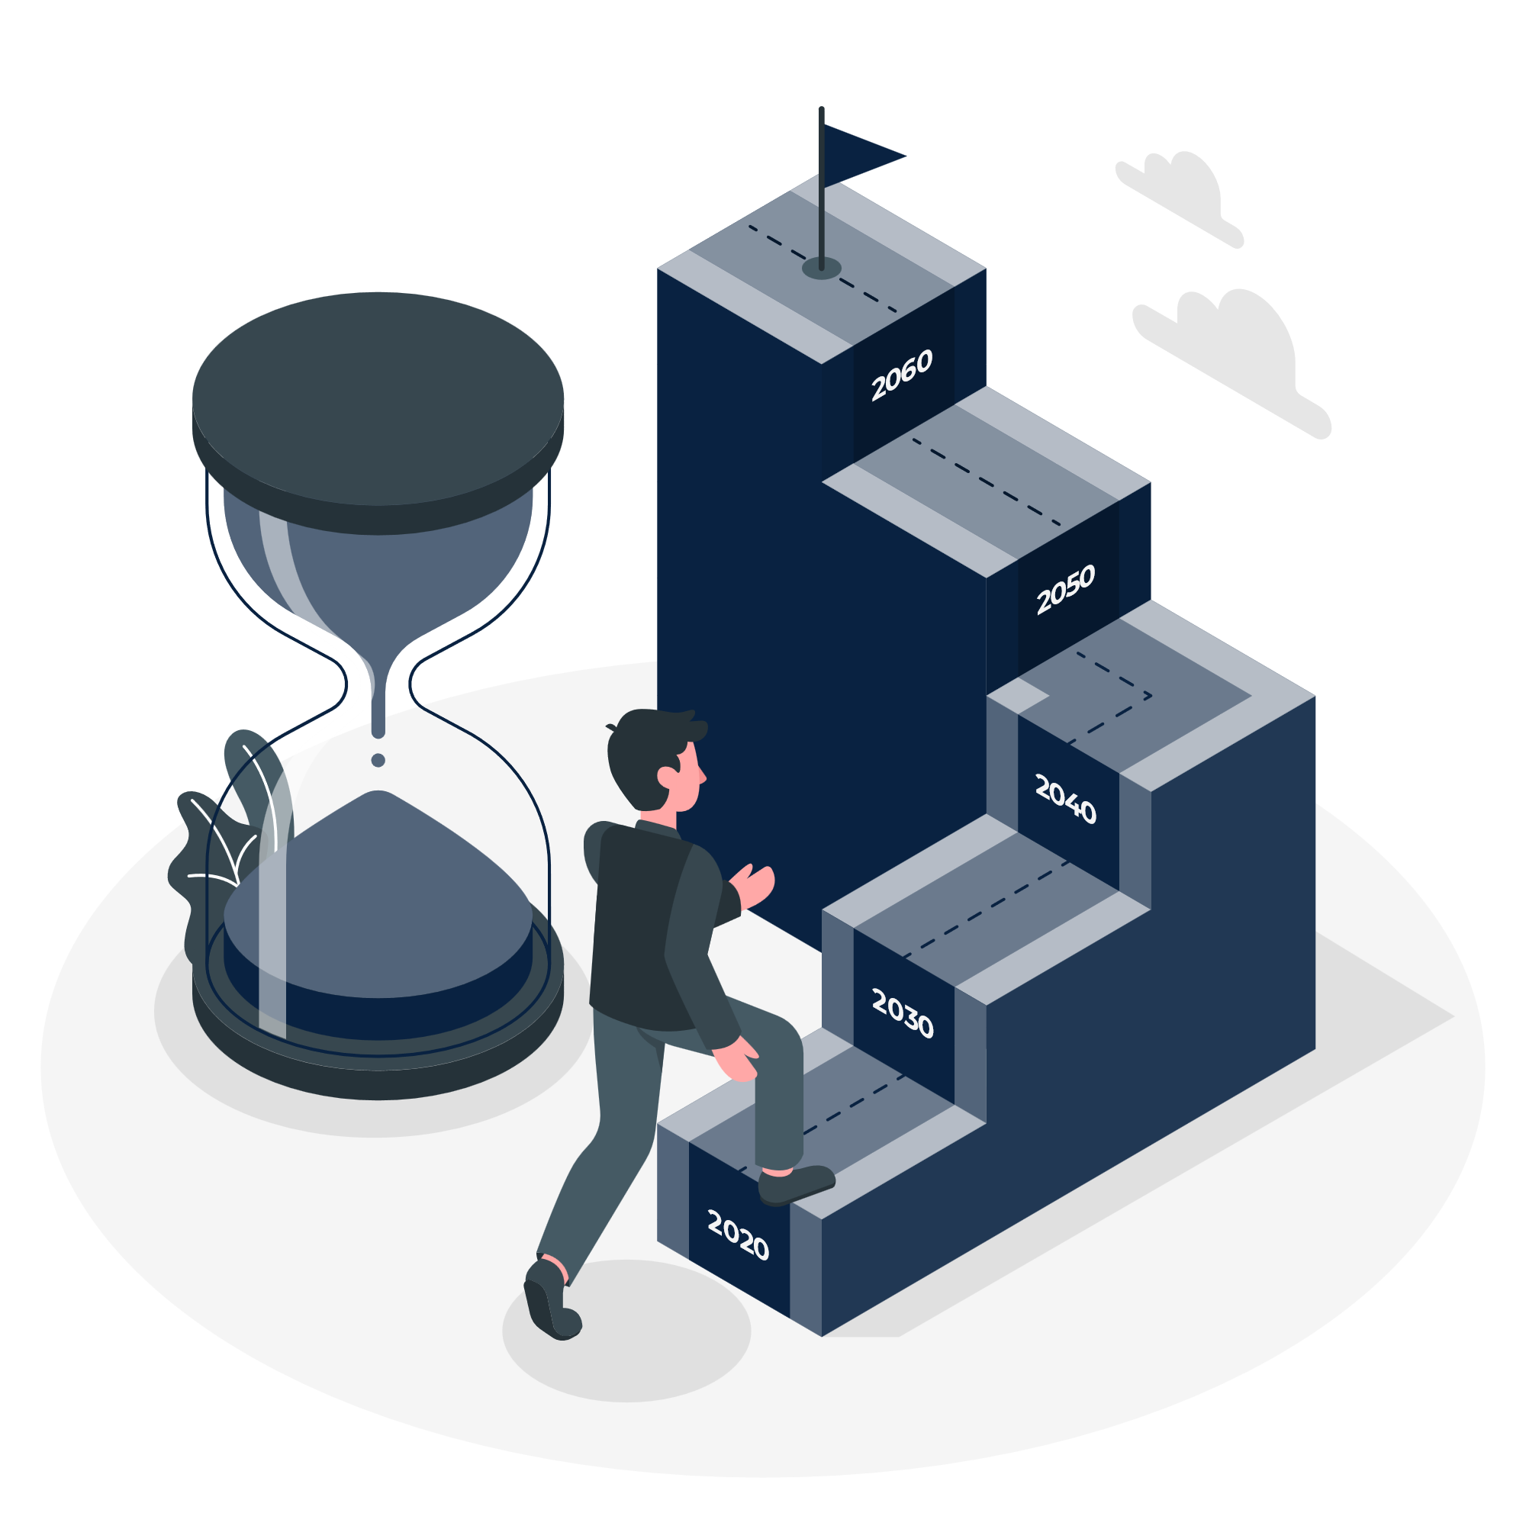
Our Roadmap
08 Our Roadmap

Slide 21


08 Our Roadmap

Slide 22
Project Timeline
09 Project Timeline

Slide 23
09 Project Timeline
 | Phase 1
 | 15/2 | 22/2 | 1/3 | 8/3 | 15/3 | 29/3
 | Phase 2
 | 5/4 | 12/4 | 19/4 | 26/4
 | Phase 3
 | 3/5 | 7/6 | 14/6
Feed
Ai Models for Diseases + LLMs
Chatbot
Mobile application
Embedded Systems
IoT
Mennat_Allah Yousri
Mennat_Allah Medhat
Sohila Lashien
Heba Atef Tolan
Abdulrahman Alsayed

Slide 24

10 Tools & Technologies
Tools
&
Technologies

Slide 25


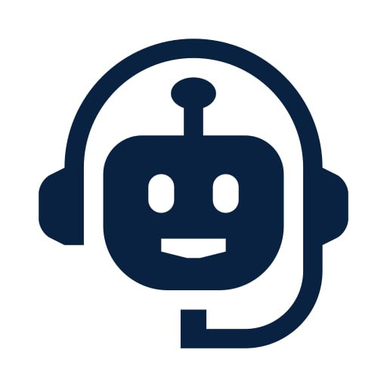
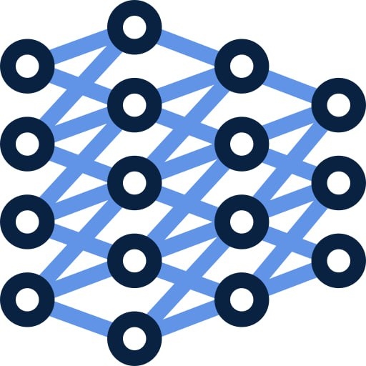

10 Tools & Technologies
Flutter
IoT
Tools
& Technologies
Embedded Systems
FastAPI
RAG & Agent
CNN

Slide 26
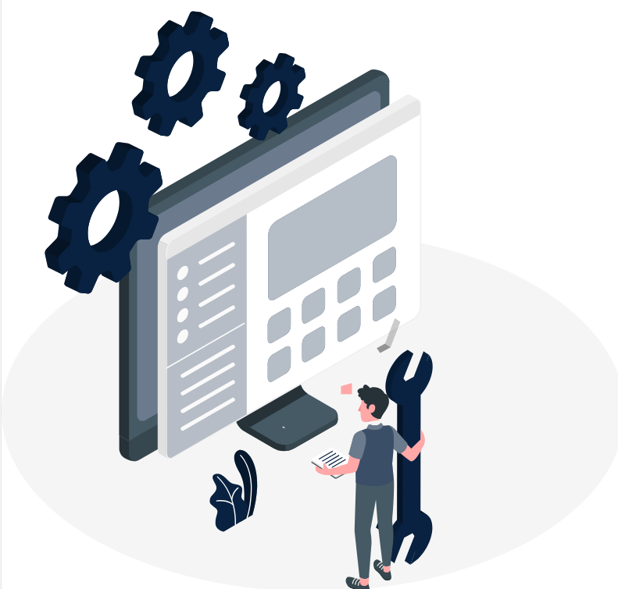
11
System
Design

Slide 27
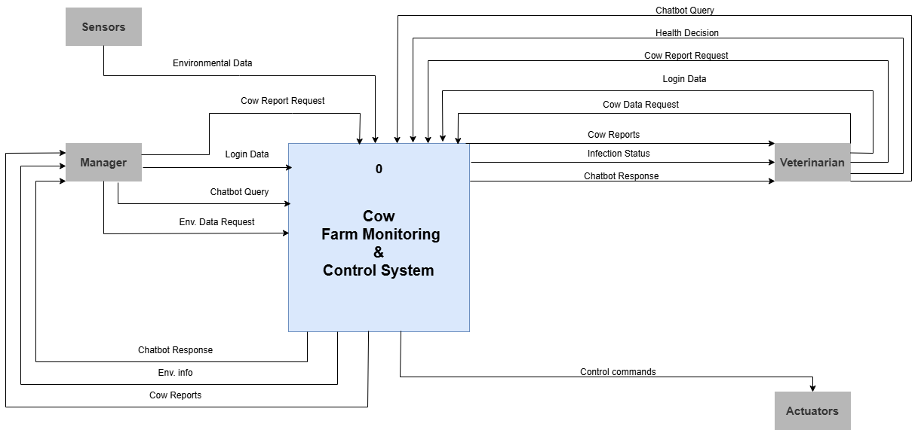
11
Context Diagram

Slide 28
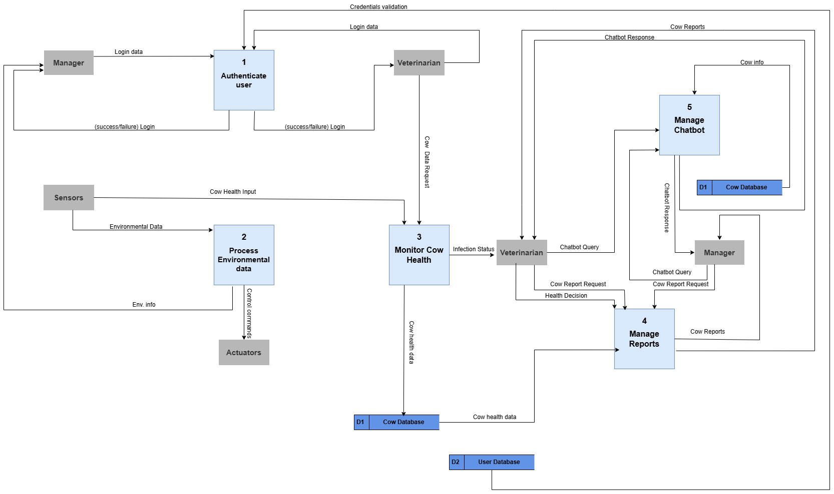
11
Level 0 Diagram

Slide 29

Feed Optimization
12 Major Problems

Slide 30
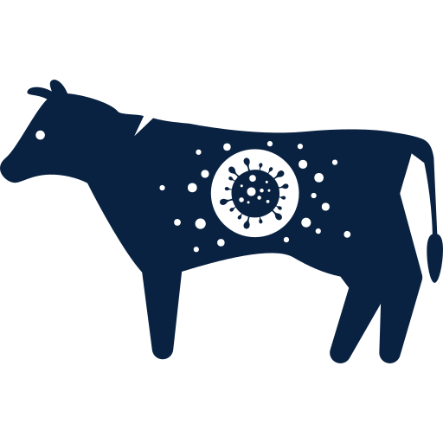

12 Major Problems
High Costs
for Feed
Common Diseases from Poor Feed
Lost Productivity

Slide 31





Major Problems
12 Our AI-driven solution
Feed Formulation Generation
CrewAI Agent-based Architecture
Nutritional Imbalance Detection
Gemini 2.0 LLM Integration
Real-world Feed Recommendations

Slide 32
12 Feed Agent
Define Components: Roughage, Concentrates, Supplements, Water
Include: type, quantity, protein %, notes, language
Generate JSON: step_1_feed_recommendation.json
BALANCE_CHECK_AGENT & FEED_KEYWORD_GENERATOR_AGENT
Cow Profile Input: type, age, weight, goal, breed, milk yield, feed
Feed_Agent:
Generate Ideal Feed Formula
Use Gemini 2.0 Flash via CrewAI LLM abstraction

Slide 33
12 Balance Agent
Input: step_1_feed_recommendation.json & current_feed
BALANCE_CHECK_AGENT
Identify 3–5 Gaps/Excesses in nutrients
Evaluate impact on productivity & suggest solutions

Slide 34
12 Keyword Agent
Input: step_1_feed_recommendation.json + cow profile
Use Gemini 2.0 Flash
Extract components from formulation
(Soybean Meal)
Generate search keywords based on type, breed, protein %
Limit to local language and country
Output JSON: step_3_feed_search_keywords.json
Pass to SEARCH_ENGINE_AGENT

Slide 35
12 Search Agent
Input: step_3_feed_search_keywords.json
Use Tavily Search Tool/API
Search local product websites using keywords
Extract details: Name, Protein %, Price, Ingredients, Rating, URL
Filter incomplete or untrusted results
Output JSON: step_4_feed_search_results.json
PROCUREMENT_REPORT_AUTHOR_AGENT

Slide 36
12 Recommended Agent
Input: step_4_feed_search_results.json + step_1_feed_recommendation.json
Use Gemini 2.0 Flash
Compare at least 3 products to ideal feed formulation
Pick best match based on nutrition, rating, URL, match_reason
Final Output: Best Feed Recommendation Report

Slide 37
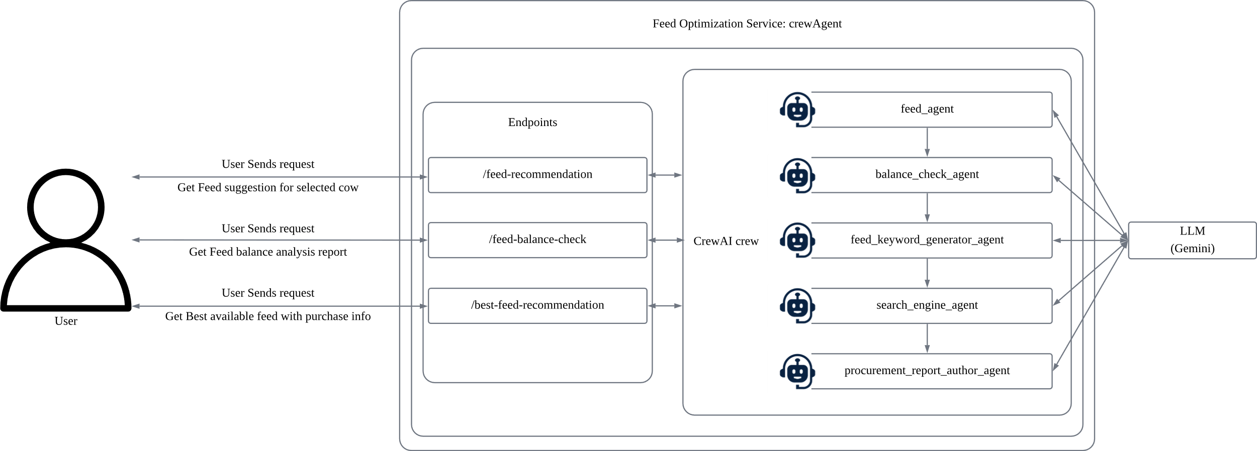
12 Architecture Overview

Slide 38

Datasets
13 Datasets

Slide 39
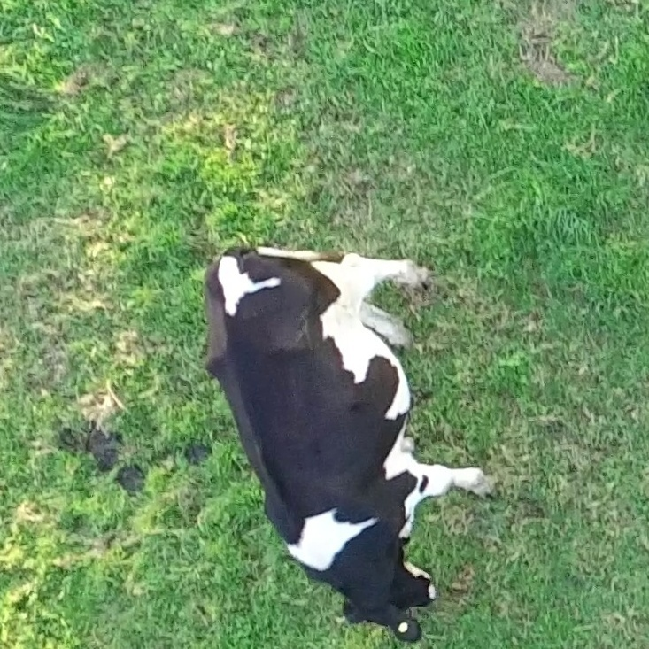
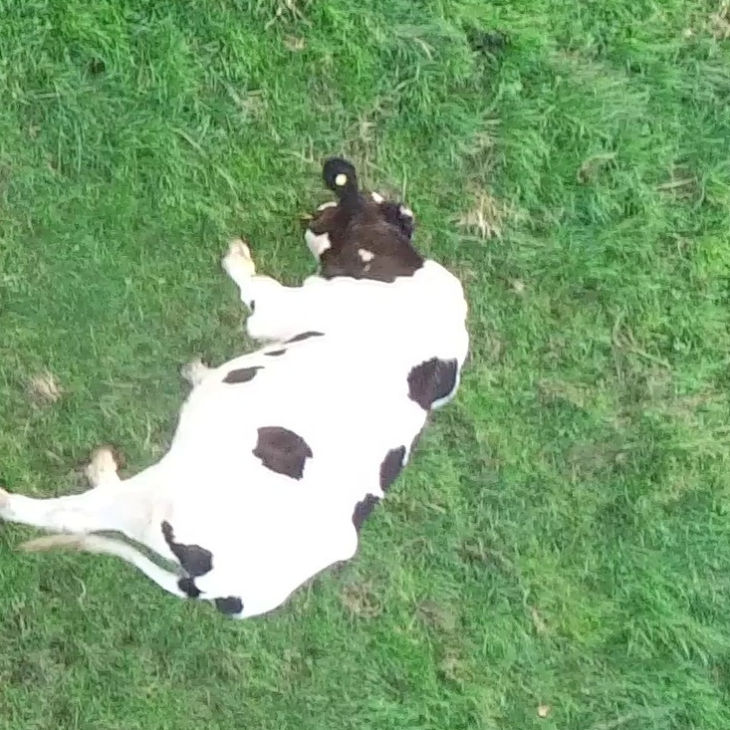
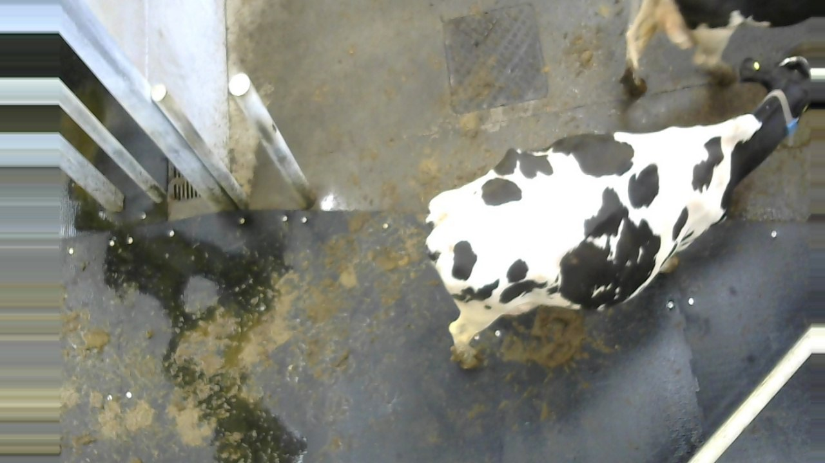
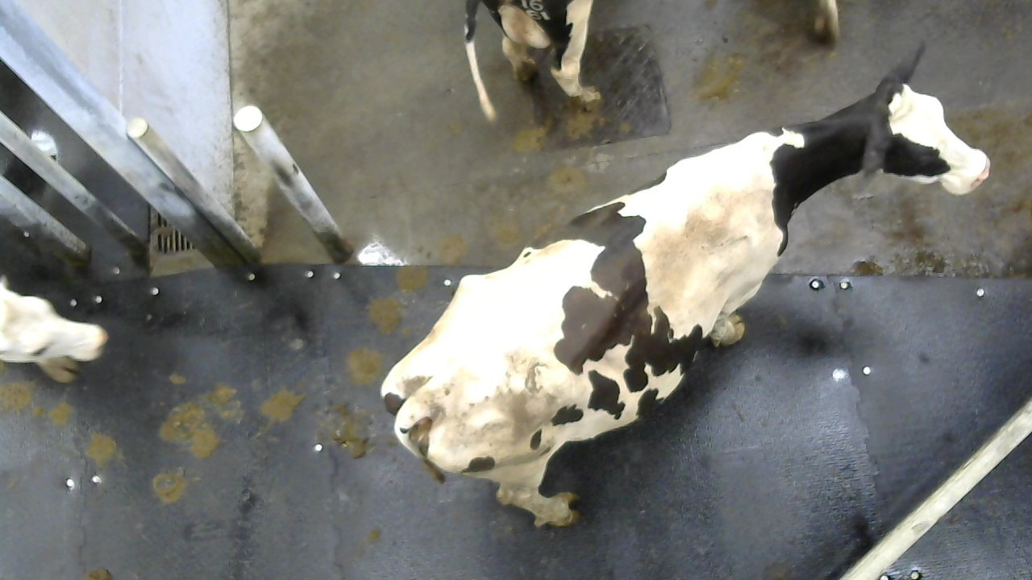
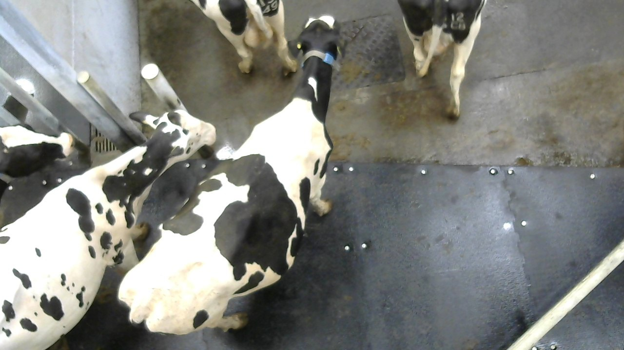
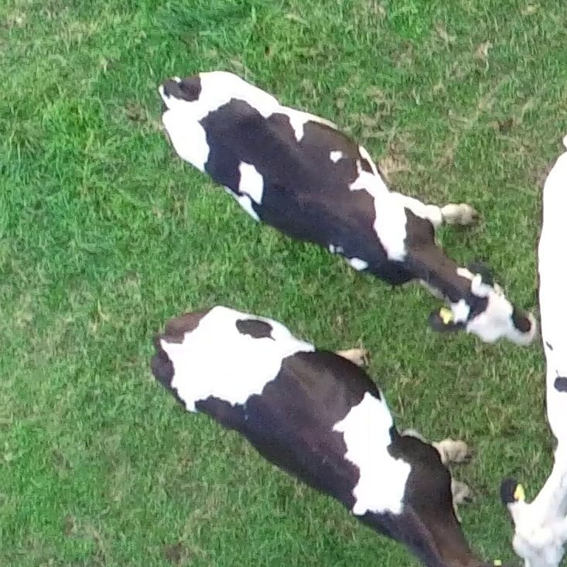
13 Datasets
Cows

Slide 40
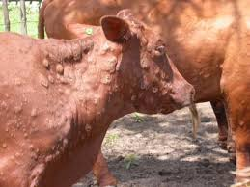
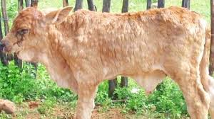
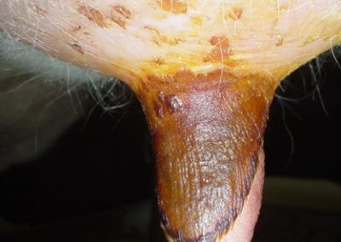
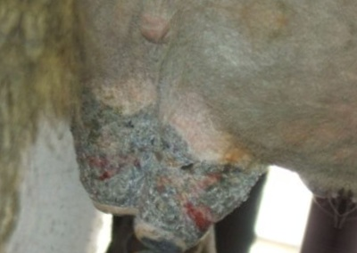
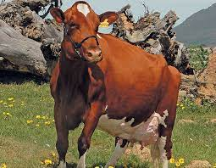
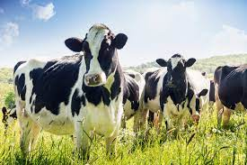
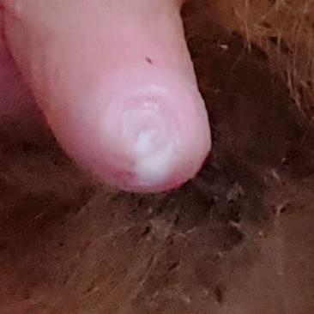
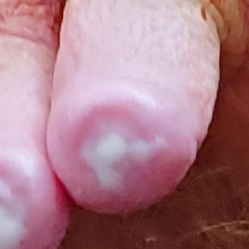
13 Datasets
Lumpy Skin
Mastitis
Lumpy
Mastitis
Normal
Normal

Slide 41
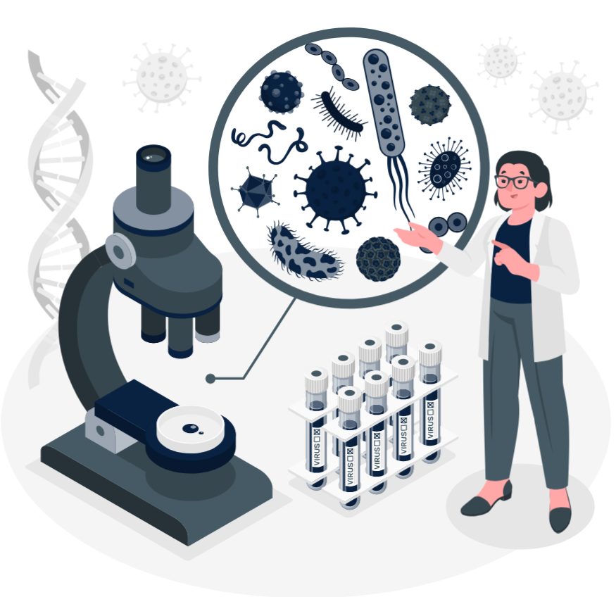
Disease Detection
14 Disease Detection Models

Slide 42

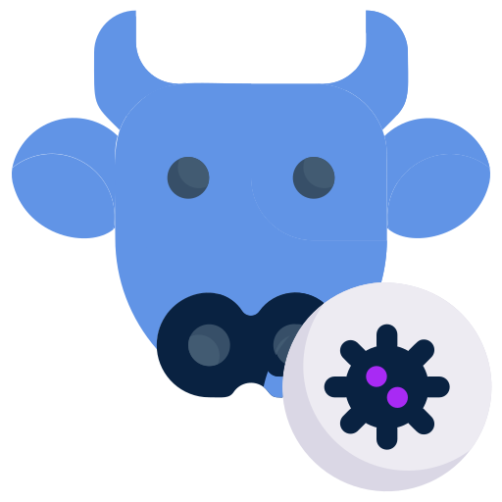

14 Disease Detection Models
Cow Detection Model
Disease Classification Model
Report Generation

Slide 43
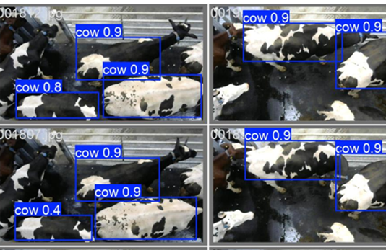
Detection Model
Purpose | Cow detection for disease analysis.
Input | RGB images captured in farm environments
Output | Bounding boxes, confidence scores for cows.
Performance | Mean Average Precision (mAP@0.5): 97.5%

Slide 44
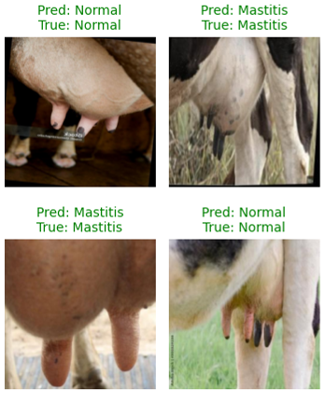
Mastitis Model
Purpose | Detect signs of mastitis in early stages.
Input | Cropped cow image from YOLO
Training | • EfficientNet-B0 • 5-Fold Cross Validation • Class weights for imbalance and bias
Output | • Label: "Healthy" or "Infected" • Confidence score
Performance | Accuracy: 99.68%

Slide 45
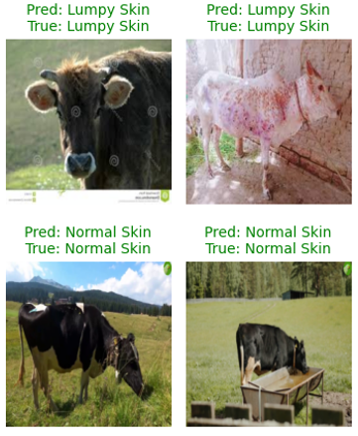
Lumpy Skin Model
Purpose | Detect visible signs of Lumpy Skin Disease
Input | Cropped cow image from YOLO
Training | • EfficientNet-B0 • 5-Fold Cross Validation • Class weights for imbalance and bias
Output | • Label: "Normal Skin" or "Lumpy Skin" • Confidence score
Performance | Accuracy: 98.69%

Slide 46
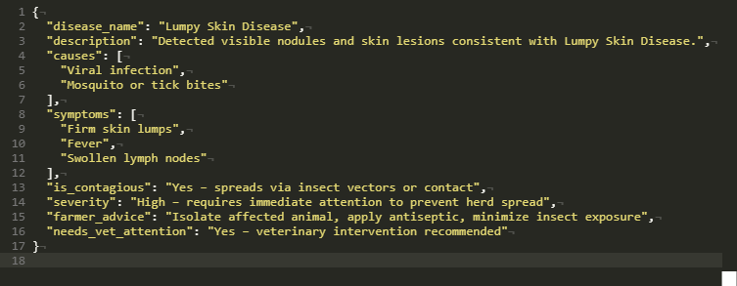
Report Generation
Purpose | Translate AI predictions into explainable veterinary reports
Input | Cow ID Timestamp Classifier Description Classifier Prediction
Model Type | Gemini 2.0 Flash (Large Language Model)

Slide 47
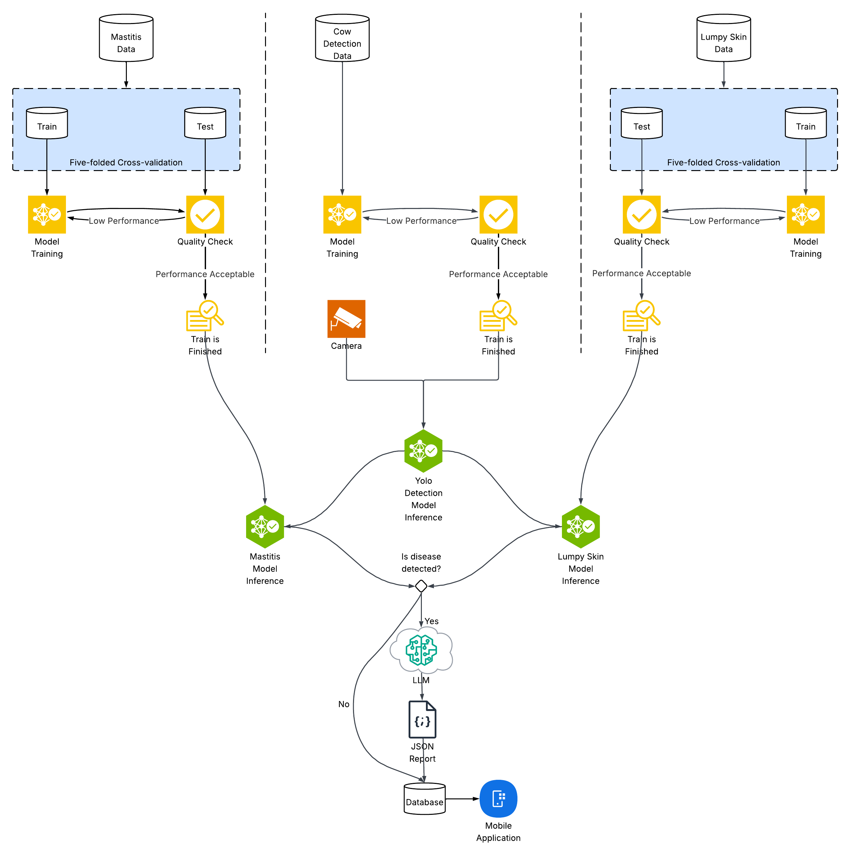
Disease Detection System Workflow

Slide 48

Smart Chatbot
15

Slide 49

15 Understanding Farmer Needs
Data Type | Example Question | Challenge
 | “What is the treatment for mastitis?” | Requires understanding of documents
Structured Data | “How many days had a temperature greater than 25°C?” | Requires analysis of sensor data
External Data | “Is there a new disease spreading?” | Needs real-time online data
Unstructured Data

Slide 50
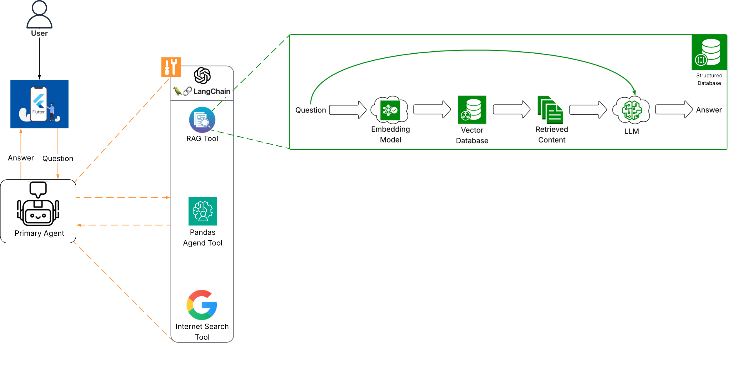
Unstructured Data

Slide 51
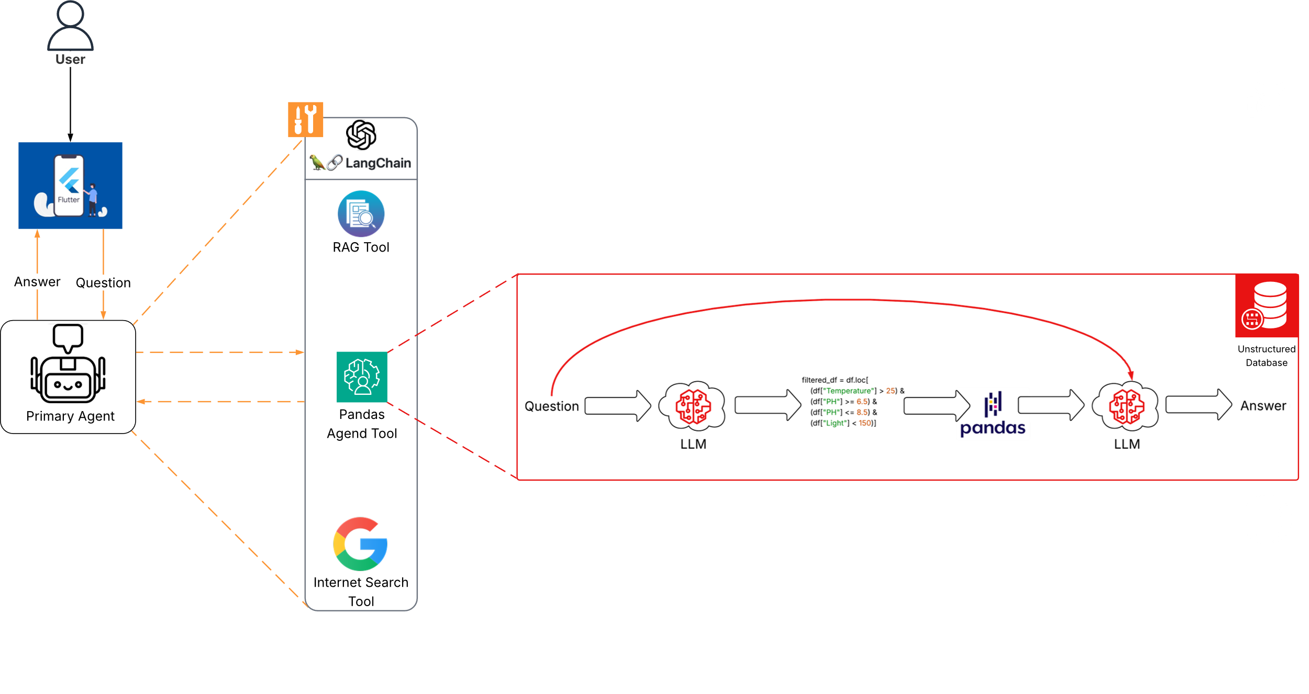
Structured Data

Slide 52
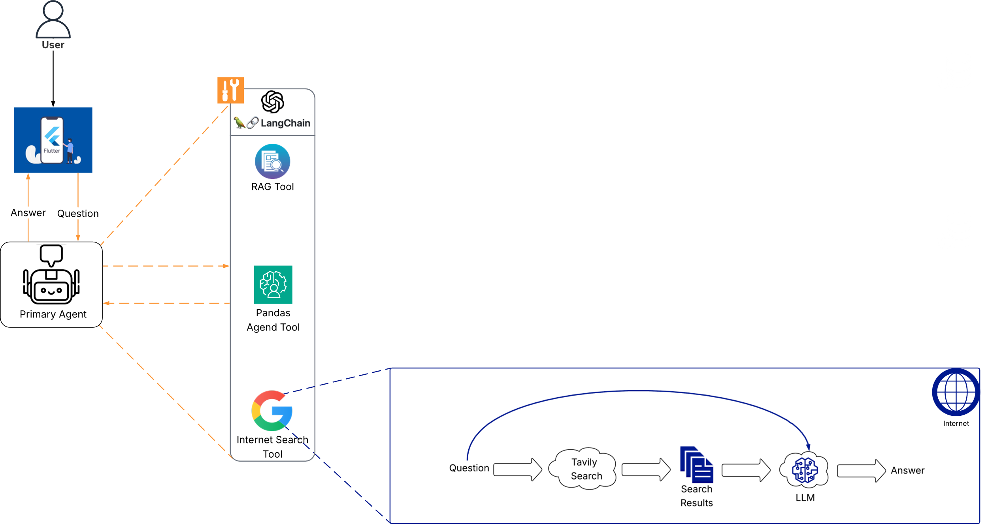
External Data

Slide 53
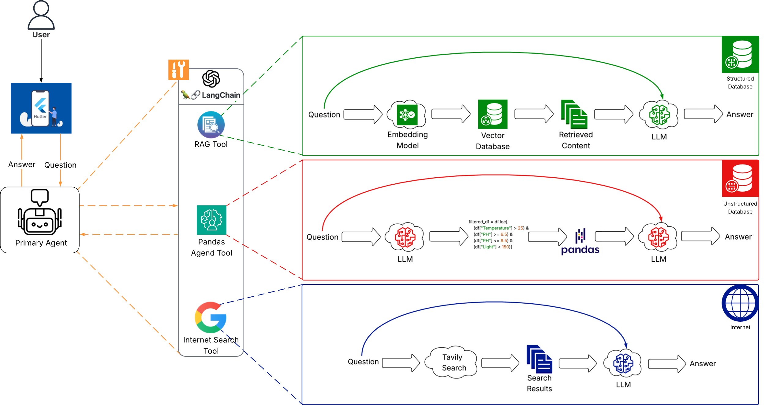
Architecture Overview

Slide 54





15 Why We Used a Multi-Agent System?
Specialized tools per data type
Scalable & easy to maintain
Smart question routing
Fast & relevant answers
Supports both farmers and vets

Slide 55
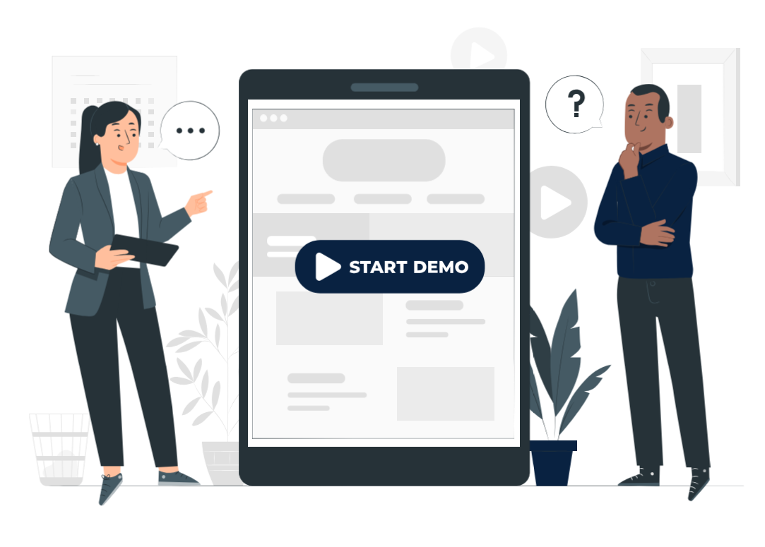
System Demo
16
01
02
Hardware
Demo
Software

Slide 56
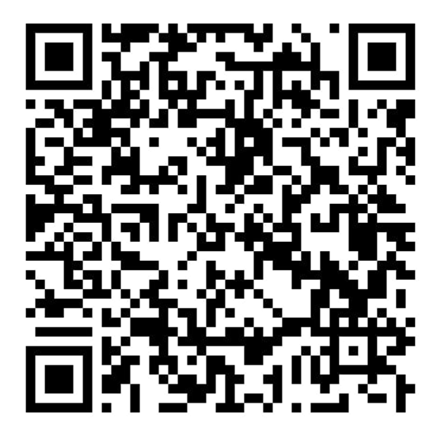
01 Hardware Demo
Scan to watch the Hardware Demo for MooNet

Slide 57
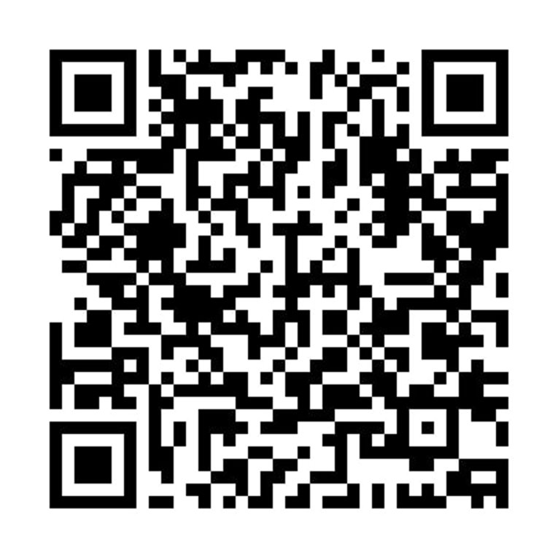
02 Software Demo
Scan to watch the Software Demo for MooNet

Slide 58

17
Upcoming
Features

Slide 59



17 Upcoming Features
Waste Management
Livestock Identifications
Historical Records

Slide 60

Thanks!
https://github.com/Menna-Yousri/Graduation_Project.git
Scan to explore the UI on Figma
Source Code on GitHub
MooNet

